Slide 1

MUM Life
By: Jonathan Tuta & Yadir Hernandez

Slide 2
Problem Statement
Managing and Renting items from the Recreation Center.
Managing and Getting information about events.
Notes:
Take Survey

Slide 3

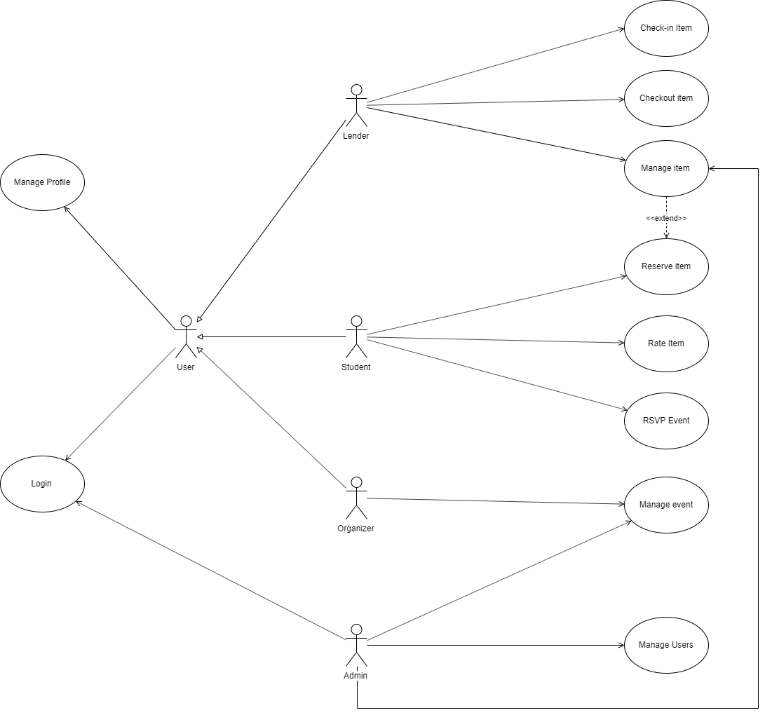
Use Case Diagram

Slide 4
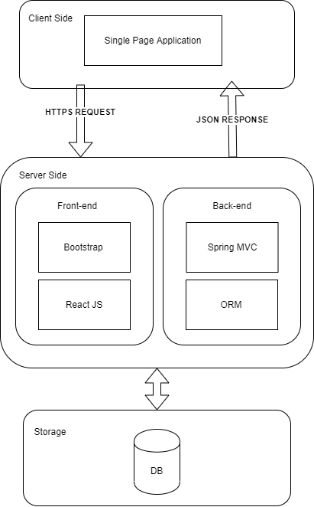
Architecture Diagram

Slide 5
Use Case Description
Name – Reserve Item
Actors Involved – Student
Pre-conditions
The Student MUST be logged in
The Item MUST be available

Slide 6
Use Case Description (Cont’d)
Flows
[ACTOR] selects the type of item he/she wants
[SYSTEM] displays the available items of the specified type
[ACTOR] Selects one of the items displayed
[SYSTEM] Displays the item details
[ACTOR] Requests the Reservation
[SYSTEM] Displays a Confirmation Screen
[ACTOR] Accepts
[SYSTEM] Displays a Success Message

Slide 7
Use Case Description (Cont’d)
Post Conditions
A new reservation record will be created
The item status will change to reserved
Business Rule
A Student cannot reserve two items at the same time

Slide 8
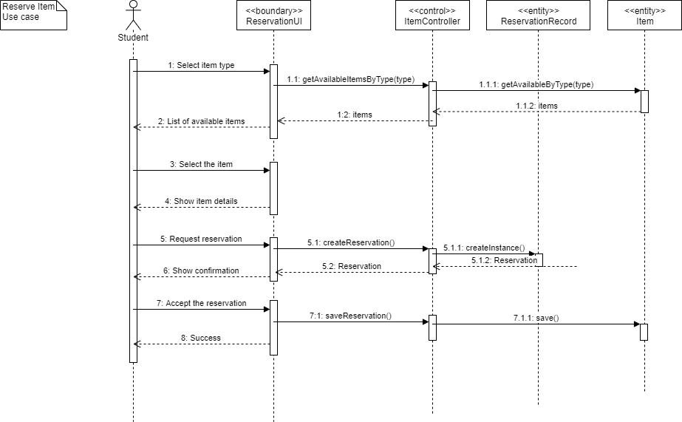

Slide 9
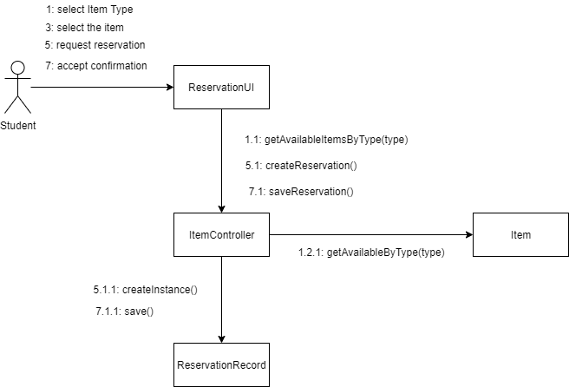
Collaboration Diagram

Slide 10
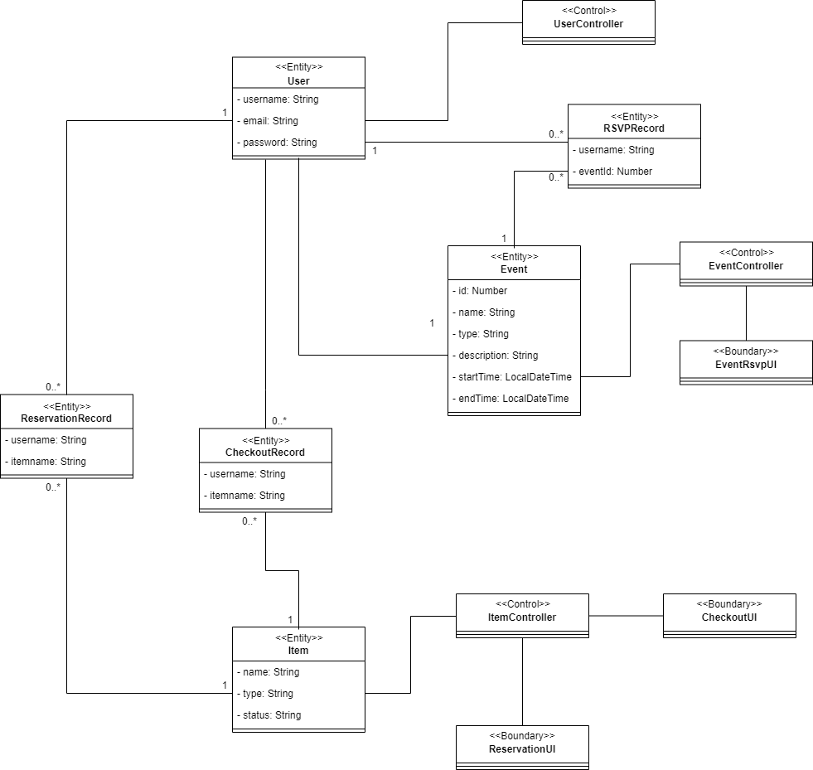
VOPC Diagram

Slide 11


Thank you!

